Slide 1

Real Estate Market
The impact of COVID-19 in Ontario’s Real Estate Market
Authors:
Emilia Lubanska, Jorge Arriola, Marina Ercoli, Monica Lin, Ulisses Pinto

Slide 2
Motivation & Summary
Goal & Hypothesis
To analyse the impact of Covid-19 on the real estate market comparing 2019 and 2020 data from Ontario.
We believe that indicators related to the real estate market will have a lower performance in 2020 than in 2019. (e.g. less houses sold in 2020 than in 2019)
Questions
What are the number of Covid-19 cases reported in Ontario? How has this number changed throughout 2020?
What is the impact of Covid-19 on the real estate market?
Does it impact the interest rates?
Is there any correlation between Covid-19 and the number of houses sold?
What about price fluctuation?

Slide 3

Data Sources
Canada Mortgage and Housing Corporation, housing under construction in all centres 10,000 and over for Canada, provinces, and selected census metropolitan areas (Type: CSV) https://open.canada.ca/data/en/dataset/1995a476-68fd-4fe2-973f-2dd47f7f6c2c
Confirmed positive cases of COVID19 in Ontario (Type: CSV)
https://data.ontario.ca/dataset/confirmed-positive-cases-of-covid-19-in-ontario/resource/455fd63b-603d-4608-8216-7d8647f43350
Average, Median and Price Percentiles for Unabsorbed Homeowner and Condominium Units (Provinces) – Ontario (Type: API)
https://www.quandl.com/api/v3/datasets/CMHC/HPPA50_ON.json?api_key=9aGzLsxCKNH7a9NEiKi5
Canadian Interest Rates and Monetary Policy Variables: 10-Year Lookup (Type: CSV)
https://www.bankofcanada.ca/rates/interest-rates/canadian-interest-rates/

Slide 4
Data Cleanup & Exploration
Cleanup process
Based on the main data frame, create a new chart that only includes the information we need
Retrieve Data
Create data frames
Note: We all agreed to create a column named ‘Date’ with the same format for all datasets. Allowing us to grouping the datasets easily.

Slide 5
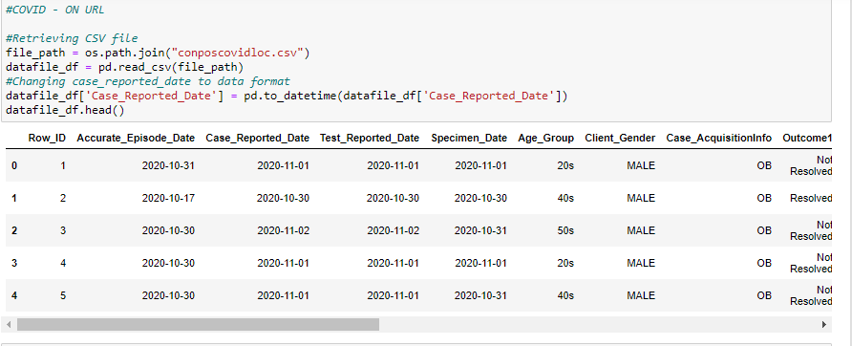
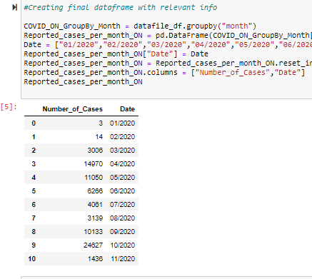
Data Cleanup
Before: Covid-19 cases in Ontario table
After: Number of Covid-19 cases in Ontario per month

Slide 6
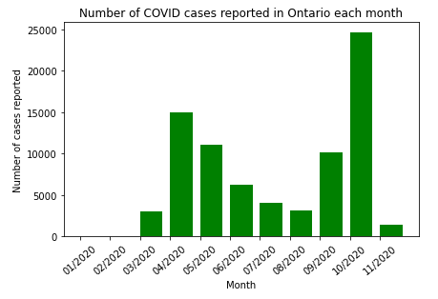
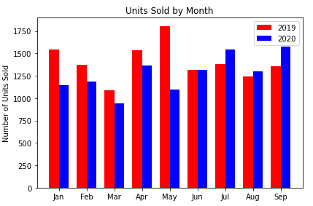
Analysis – Part 1→ We plot the information we retrieved from our datasets
Number of Covid-19 cases in Ontario
Number of units (i.e. houses) sold in Ontario
Observation: We can clearly notice the two Covid-19 ‘waves’ in April and October
Observation: We notice that the number of houses sold has not significantly decreased throughout 2020

Slide 7
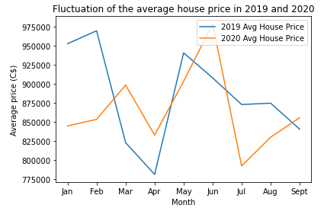
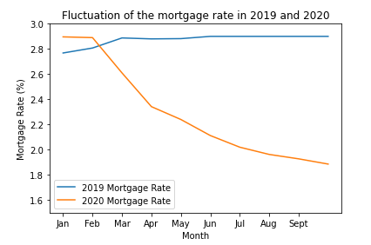
Analysis – Part 1→ We plot the information we retrieved from our datasets
House prices in 2019 vs. 2020
Mortgage rate in 2019 vs. 2020
Observation: There is a decrease in the average house price in July 2020.
Question: Is it correlated with COVID-19 cases?
Observation: It is clear that the mortgage rate is lower in 2020 vs. 2019

Slide 8
Analysis – Part 1→ We plot the information we retrieved from our datasets
House prices in 2019 vs. 2020
Mortgage rate in 2019 vs. 2020
Observation: There is a decrease in the average house price.
Question: Is it correlated with COVID-19 cases?
Observation: It is clear that the mortgage rate is lower in 2020 vs. 2019

Slide 9
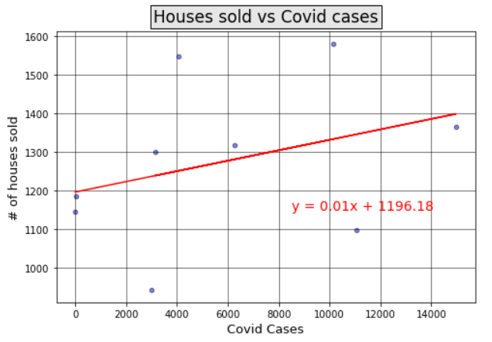
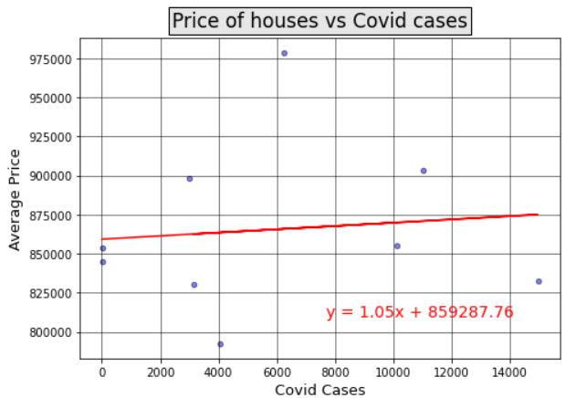
Analysis – Part 2→We determine if there is a correlation between the number of reported Covid-19 cases and the real estate variables
Regression analysis of number of houses sold and Covid-19 cases
Regression analysis of price of houses and Covid-19 cases
Correlation coefficient: 0.34
There is a weak correlation between the number of Covid-19 cases reported each month and the monthly number of houses sold in Ontario throughout 2020
Correlation coefficient: 0.1
There is a very weak correlation between the monthly changes in Covid-19 cases and the price of houses sold in Ontario throughout 2020

Slide 10
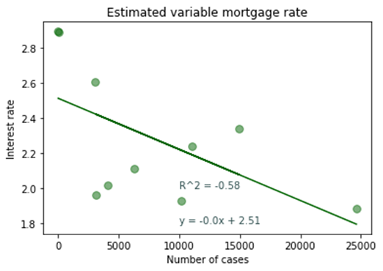
Analysis – Part 2→We determine if there is a correlation between the number of reported Covid-19 cases and our real estate variables
Regression analysis of mortgage rate vs. number of Covid-19 cases
Correlation coefficient: -0.58
There is a moderate negative correlation between the number of Covid-19 cases reported each month and the monthly changes in the mortgage rate.

Slide 11
Findings: The behavior of 2020 real estate indicators in Ontario cannot be clearly explained by only looking at the progression of Covid-19
1. Number of houses sold:
Visual inspection: The monthly number of houses sold in Ontario in 2019 and 2020 are very similar.
Regression analysis: With a correlation coefficient of 0.34, there is a weak correlation between the monthly changes in Covid-19 cases and the monthly number of houses sold.
2. Average price of houses:
Visual inspection: There are fluctuations in the average price of houses. The lowest point of this value in 2020 was in July. There is no clear trend visible.
Regression analysis: With a correlation coefficient of 0.1, there is a weak correlation between the monthly changes in Covid-19 cases and the monthly average price of house in Ontario.
3. Mortgage rate:
Visual inspection: The mortgage rate is lower in 2020 than in 2019. This may be a response from banks to the impact of Covid-19.
Regression analysis: However, with a correlation coefficient of -.58, there is a moderate negative weak correlation between the monthly changes in Covid-19 cases and the downward trend of the mortgage rate

Slide 12

Post Mortem
Difficulties that arose:
Covid-19 cases in ON: Using a json file, we found the number of COVID cases in Ontario per month. However, the numbers did not seem right. Once, we retrieved the CSV version of the dataset, we noticed that the json file was, indeed, incomplete. We decided to use the CSV dataset instead.
We initially created our final notebook by retrieving our final CSV files. We then transitioned to use %run. When doing this, we encountered a few errors. Column headers were different in the CSV files than in the data frames, and some CSV files were not saved within our Github folder. We had to spend some time organizing our files and collaborating so the person using %run had all the information she needed.

Slide 13
Post Mortem
Additional questions | What would we research next?
We would try to retrieve October & November data for all indicators. We are experiencing the second wave of Covid-19, and this key to understand how Covid-19 and the real estate market relate.
GeoPandas: We would provide more granular answers → We would map out the number of Covid-19 cases, and number/price of houses being sold per city within Ontario.

Slide 14
Thank You!
Our photo to be added
Covid-19
Emilia Lubanska, Jorge Arriola, Marina Ercoli, Monica Lin, Ulisses Pinto

